Slide 1
Exam Study Skills
Revision, organisation and exam anxiety management techniques for Teenagers

Slide 2
Contents
Preparation
Getting Motivated
Anxiety Management
Confidence Building
Revision Toolbox
Antonia Behan Qualified Psychologist MBPsS ICF trained Coach
BSc (Hons) Psychology. Cert Coach (2004)
antonia@antoniabehan.com +34 620 741 361 www.antoniabehan.com
All Rights Resevered. Copyright © Antonia Behan 2017
This item may not be copied, sold or reproduced in any part or whole, or used as a presentation by another party without my written permission.

Slide 3
Preparation

Slide 4
Prepare to Revise
WIIFM
What’s In It For Me?

Slide 5
Revision Timetable
Mon | Tues | Wed | Thurs | Fri | Sat | Sun
School | School | School | School | School | Exercise Revision 2 hours Lunch | Exercise Revision 2 hours Lunch
Relax 1 hour | Relax 1 hour | Relax 1 hour | Relax 1 hour | Relax 1 hour | Relax 1 hour | Relax 1 hour
17.30 Sports 1 hour | 17.30 Revision 2 hours | 17.30 Revision 2 hours | 17.30 Revision 2 hours | 17.30 After school club | Revision 2 hours | Fun
19.00 Revision 2 hours | 19.30 Family time | 19.3o Social media catch up! | Chores | Fun | Fun | Relax
Relaxing dinner with family | 21.00 Revision 1 hour | 21.00 Revision 1 hour | Relaxing dinner with family | Fun | More Fun | Relax

Slide 6
Anxiety Management

Slide 7
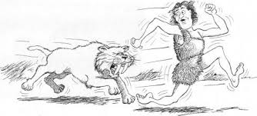
What is Anxiety?
A Feeling Of:
Being anxious to please
A strong desire or urge to do something
Being afraid of the unknown
Helpless or being out of control
Worry
Intense fear
Nervousness
Unease
Uncertainty

Slide 8
How Much is Too Much?
Excessive Worrying: worrying about things that cannot be controlled, preoccupied with events that are unlikely to happen, catastrophic thinking, or a general feeling of dread; that something bad is going to happen.
Trouble Functioning Socially: feeling generally anxious, worrying about what others might think, or a nervous mood that makes it difficult to enjoy anything can impact on friendships, create withdrawal and isolation.
Constant Anxiety: When the anxiety is not just in response to something that is outside ones comfort zone or a particular fear, but the anxious feelings are there most of the time.

Slide 9
The Development of Anxiety
Anxiety is a complex issue. According to developmental models it is the result of multiple factors in relation to context and time. The biopsychosocial model proposes there are multiple, and inter-related causes of pathological anxiety.
Biological Factors: Genetic vulnerability and the natural adaptive responses to environmental stress.
Psychological Factors: Early experiences and perceptions of the world, may form negative beliefs about the self and the world, that contribute to the development of anxiety.
Social Factors: Social learning/copy behaviour, may influence how individuals experience anxiety.

Slide 10
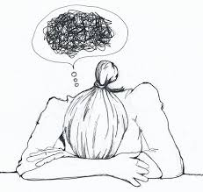
Exam Anxiety Triggers
Fear of failure
Feeling unable to cope with time pressure
Wanting parents to be proud
Fear of being judged or alienated
Desiring perfection
Associating grades with self-worth
Fear of being embarrassed by low grades
Fear that future dreams will be crushed
Fear of running out of time
Fear of forgetting

Slide 11
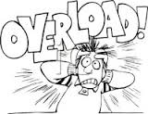
Coping Skills: #1 STOP THINKING!
Silently shout to yourself "Stop"
This exercise stops one negative thought turning into a story of catastrophe.
Then, distract yourself, or try some of the exercises in the following slides…

Slide 12
Coping Skills: #2 Reframe
Ask yourself:
Q: Is this actually happening,
or is this what you are imagining happening?
And,
Q: What is the likelihood of this actually happening?

Slide 13
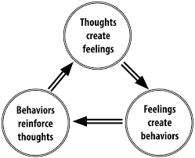
Coping Skills: #3 Mind Management
Notice what you are thinking
Ask yourself, ‘Is this positive or negative?’
Be Your Own Cheerleader!
Choose positive thoughts
‘I can do this’ …‘It will be okay’
Choose actions that support WHAT YOU WANT, NOT WHAT YOU FEAR
Revise
Take rest breaks
Do things that make you happy

Slide 14
Positive Thoughts
I can do this
Whatever happens, I will be okay
If I don’t get the grades, I will find another way
I am supported
I am loved and cared about
There is so much more in life than grades
I am intelligent
I am creative
I am great with people
I can create my own opportunity in other ways
Things could turn out better than I imagine
It is going to be okay

Slide 15
Coping Skills: #4 Validate Positivity
Things are going to be okay because this time ………………………………………………………………………………...
If I don’t get the grade I want it is not the end of the world, what I can do is………………………………………………………………………………
I got a D last semester, but I can now use my study skills to improve, so what I am going to do is……………………………………………………..
I went blank on the last test, but I now know how to reduce test anxiety
………………………………………………………………………………

Slide 16
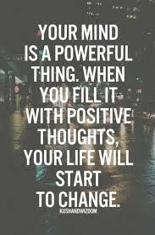
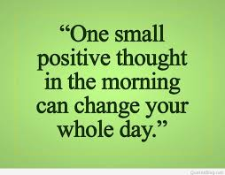
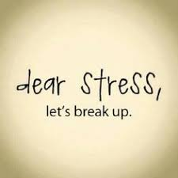
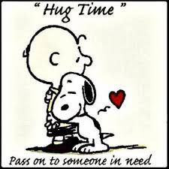
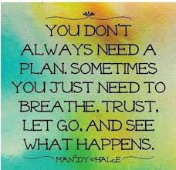
I choose to believe in myself, because I love, accept and care about myself.

Slide 17
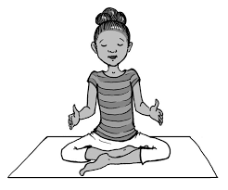
Coping Skills: #5 Breathe
DEEP BREATHING
1. Sit straight up in your chair in a good posture position.
2. Slowly inhale through your nose.
3. As you inhale, first fill the lower section of your lungs and work your way up to the upper part of your lungs.
4. Hold your breath for a few seconds.
5. Exhale slowly through your mouth.
6. Wait a few seconds and repeat the cycle

Slide 18
Coping Skills: #6 Create a Calm Place
Close and cover your eyes using the centre of the palms of your hands.
Think of some real or imaginary relaxing scene.
Mentally visualize this scene. Picture the scene as if you were actually there, looking through your own eyes.
Visualize this relaxing scene for one to two minutes.

Slide 19
Coping Skills: #7 Be kind
Encourage yourself
Remind yourself what you are good at
Choose to hold positive thoughts
Give yourself the best opportunity you can
Accept your abilities
Remember who you are is not based on your school grades
Motivate yourself with positive language
Plan some fun and exciting rewards for all your hard work

Slide 20
Revision Tools

Slide 21
Revision Tools
1. Create a Supportive Environment
2. Assign Study Times

Slide 22
Revision Timetable
Mon | Tues | Wed | Thurs | Fri | Sat | Sun
School | School | School | School | School | Exercise Revision 2 hours Lunch | Exercise Revision 2 hours Lunch
Relax 1 hour | Relax 1 hour | Relax 1 hour | Relax 1 hour | Relax 1 hour | Relax 1 hour | Relax 1 hour
17.30 Sports 1 hour | 17.30 Revision 2 hours | 17.30 Revision 2 hours | 17.30 Revision 2 hours | 17.30 After school club | Revision 2 hours | Fun
19.00 Revision 2 hours | 19.30 Family time | 19.3o Social media catch up! | Chores | Fun | Fun | Relax
Relaxing dinner with family | 21.00 Revision 1 hour | 21.00 Revision 1 hour | Relaxing dinner with family | Fun | More Fun | Relax

Slide 23
Revision Skills
Understand chapter themes
What do you already understand?
Underline key information and copy into notebook
Highlight key facts and copy into notebook
Use Bullet Points
Explain what you have learnt to someone
Memorise key issues and ask to be tested
Revision Cards

Slide 24
You Can Do This It’s Going to be Okay

Slide 25
Antonia Behan Qualified Psychologist ICF trained Coach BSc (Hons) Psychology. Cert Coach (2004) antonia@antoniabehan.com +34 620 741 361 www.antoniabehan.com

